Slide 1
Caring from Within: Team 1
Aaron Han, Derek Chung,
Michelle Xu, Tristan Wang

Slide 2
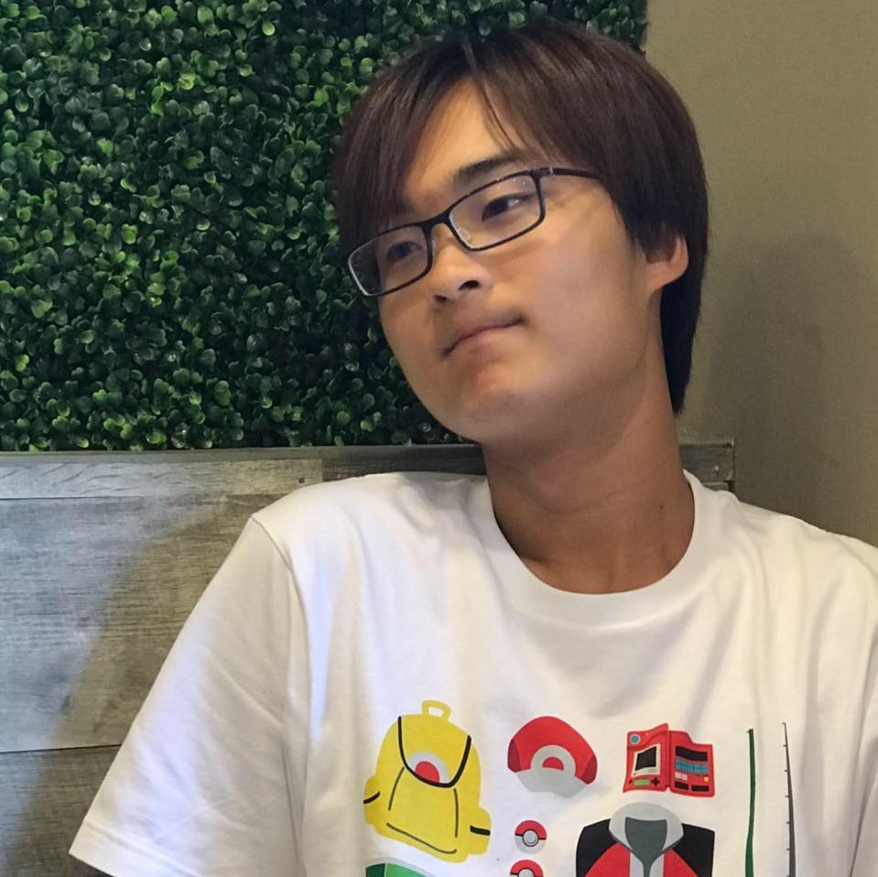


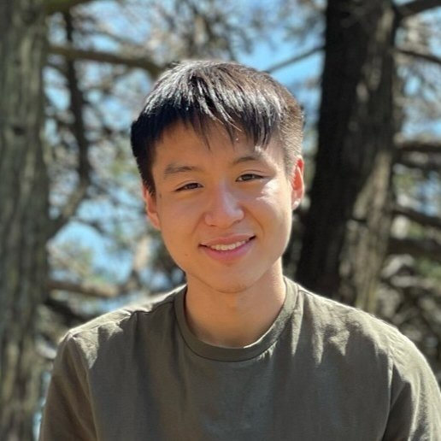
Introduction
Tristan W.
Michelle X.
Aaron H.
Derek C.

Slide 3
Introduction
Refined Problem Domain
Tristan W.
Michelle X.
Aaron H.
Derek C.
Notes:
Initial problem domain: mental health issues

Slide 4
Introduction
Refined Problem Domain
Last week: Mental health issues that have been amplified by COVID
Tristan W.
Michelle X.
Aaron H.
Derek C.

Slide 5
Introduction
Refined Problem Domain
Last week: Mental health issues that have been amplified by COVID
This week: Focus on the dynamics among people who are living together in the same space and how we can ease any tensions
Tristan W.
Michelle X.
Aaron H.
Derek C.

Slide 6

2. Initial Point of View
We met Jessie, a Class of 2020 Stanford alumni and former PHE who is currently working as a freelancer living in Arizona

Slide 7
2. Initial Point of View
We met Jessie, a Class of 2020 Stanford alumni and former PHE who is currently working as a freelancer living in Arizona
We were surprised to notice that the most notable emotion she felt due to COVID was privilege guilt rather than loss

Slide 8
2. Initial Point of View
We met Jessie, a Class of 2020 Stanford alumni and former PHE who is currently working as a freelancer living in Arizona
We were surprised to notice that the most notable emotion she felt due to COVID was privilege guilt rather than loss
We wonder if this means she thinks she needs to be doing more with her position of privilege

Slide 9
2. Initial Point of View
We met Jessie, a Class of 2020 Stanford alumni and former PHE who is currently working as a freelancer living in Arizona
We were surprised to notice that the most notable emotion she felt due to COVID was privilege guilt rather than loss
We wonder if this means she thinks she needs to be doing more with her position of privilege
It would be game-changing to have an avenue where people can use their privilege to make a positive impact

Slide 10

3. Additional Needfinding Results
Living situation during pandemic:
Lived with 7 others in New York City, 3 bedrooms, all doing remote work
Results:
Minor inconveniences included slower wifi, scheduling meetings, faulty AC at times, and someone having to sleep on the couch
Had very little conflict with roommates, possibly due to them being close friends
Would have liked to known if roommates are heavy/light sleepers before moving in
Prefers own bed room, currently has own bedroom in apartment suite
Andrew Zhang, Software Engineer

Slide 11
4. POV #1
We met: Andrew, a recent graduate from Georgia Tech, who spent his summer living with 7-10 people in a 3 bedroom apartment in NYC.
We were surprised to notice: how Andrew mentioned how they never had any disagreements or conflicts living together in such a tight space for so long.
We wonder if this means: it is possible to have a seamless relationship with roommates even in such a tight space.
It would be game-changing to: have a way to group roommates together who would potentially get along well, just like Andrew’s group.
Notes:
Andrew HMW:
HMW help roommates develop a sense of empathy to avoid conflict?
HMW help roommates realize when one person has been doing more than their fair share of chores?
HMW make a crammed living environment more sustainable?
HMW help roommates understand each others’ love languages?
HMW identify who is a light sleeper and who is not?
HMW encourage roommates to be more thoughtful for each other?
HMW help roommates come up with a fair split of rent depending on living situation?
HMW ensure that the utilities in a new apartment are up to standards?
HMW help roommates communicate better to resolve conflicts?
HMW help roommates who didn’t know each other previously become closer?

Slide 12
How might we…
help roommates realize when one person has been doing more than their fair share of chores?

Slide 13

3. Additional Needfinding Results
Living situation during pandemic:
Lived in New York 400/500sq ft apartment with 2 others
Lived in San Francisco, 3 bed, 2 bath, 4 other people
Results:
Minor annoyance: woke up roommate in NY due to shifting in sleep, different sleep schedules, and close proximity of beds
Thinks that cleanliness standards and respect of personal space are important in successful roommate relationships
San Francisco apartment had several problems, including uneven split of chores, messy living space, and aversion to discussing these conflicts
Diane Jiang, Consultant

Slide 14
4. POV #2
We met: Diane, a current consultant at Strategy& who is living with 3 other people in San Francisco.
We were surprised to notice: how much she cares about having her own space and her annoyances at previous living situations where people had incompatible schedules.
We wonder if this means: one's living experience is really dependent on the people they're living with.
It would be game-changing to: have a way of finding people who are aware of and compatible with each others’ living preferences.
Notes:
HMW encourage an even division of chores among roommates?
HMW help people find others who they are compatible living with?
HMW ensure that light sleepers aren’t disturbed?
HMW ensure that guests won’t keep their hosts up at inconvenient times?
HMW help residents feel like they have their own space in a shared room?
HMW help non-confrontational roommates speak up?
HMW give people the foresight on whether a living situation will be good or bad?
HMW aid a fair distribution of rooms when deciding who gets which room?
HMW help people gauge the vibe of a roommate prior to them actually rooming together?
HMW help light sleepers sleep through big noises?
HMW make roommates more receptive to each others’ preferences?

Slide 15

How might we…
help people find others who they are compatible living with?

Slide 16
3. Additional Needfinding Results
Living situation during pandemic:
Lived with parents in Palo Alto from March 2020-August 2020
Lived with 3 roommates at Berkeley from August 2020-June 2021
Results:
Got closer to parents and roommates due to restricting environment
Conflicts included how to split rent and utilities among roommates, specifically when some went back out due to the pandemic
Imbalance of chores due to sublet and lack of initial discussions surrounding topic
David Shau, EECS Major at Berkeley

Slide 17
4. POV #3
We met: David, a senior undergraduate at Berkeley who has shared apartments with groups of roommates of various sizes over the past 2 years during the COVID lockdown.
We were surprised to notice: that he ended up paying more than his fair share of the utility bill.
We wonder if this means: he and his roommates had difficulty on how to split rent fairly because it was too complicated and tedious.
It would be game-changing to: have a way for people to split living costs fairly based on individual circumstances.
Notes:
HMW help establish the distribution of living costs for roommates?
HMW help determine how much someone should pay for a specific living cost?
HMW address sudden changes in living situations and the effect on rent?
HMW ensure roommates adhere to roommate contracts (if they have one)?
HMW help multiple people be on a call in the same room?
HMW make it easier for landlords/lease companies to make it easier for multiple people to contribute to rent?
HMW design living spaces where each room has privacy?
HMW help establish what a ‘fair share’ of rent is?
HMW help resolve conflicts over shared expenditures?
HMW notify individuals who are using much more than the average amount of utilities?

Slide 18
How might we…
help determine how much someone should pay for a specific living cost?

Slide 19
How might we…
help roommates realize when one person has been doing more than their fair share of chores?
help people find others who they are compatible living with?
help determine how much someone should pay for a specific living cost?

Slide 20
Solution 1: Roommate Matching App
How might we help people find others who they are compatible living with?

Slide 21
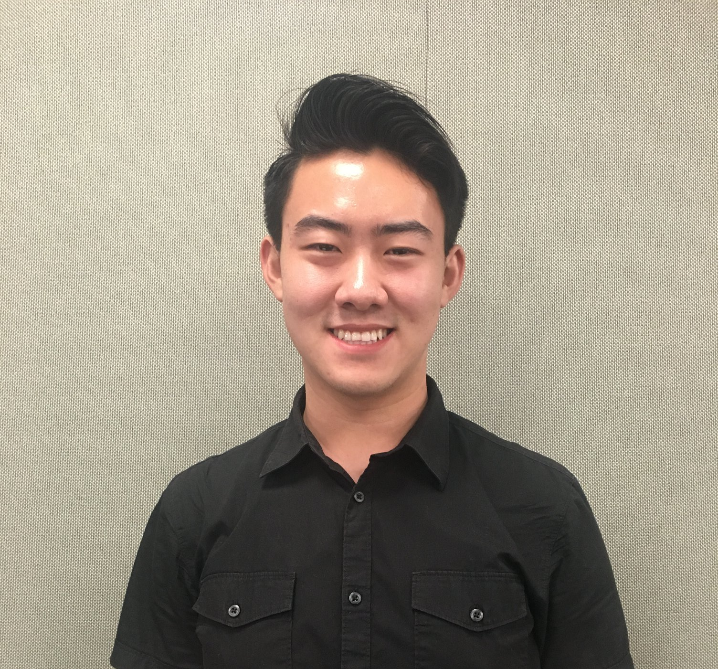
Roommate Matching App
The Participant:
Derrick, a soon-to-be Stanford new grad who is looking for potential roommates to live with in NY currently.

Slide 22
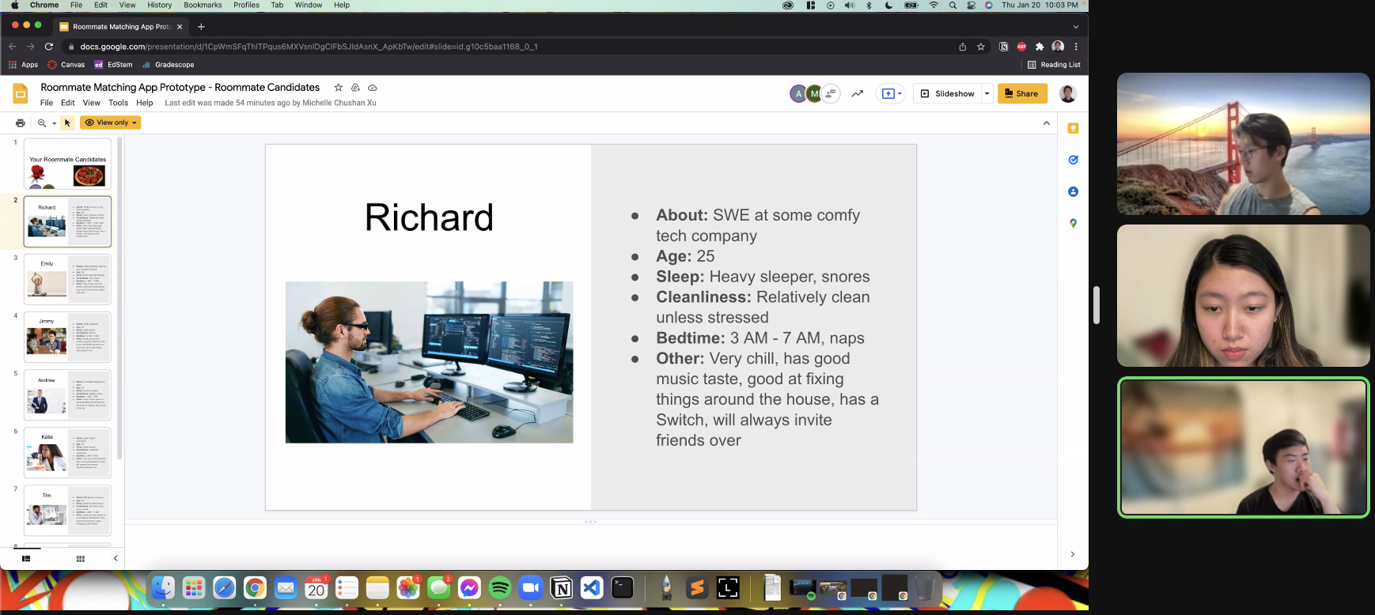
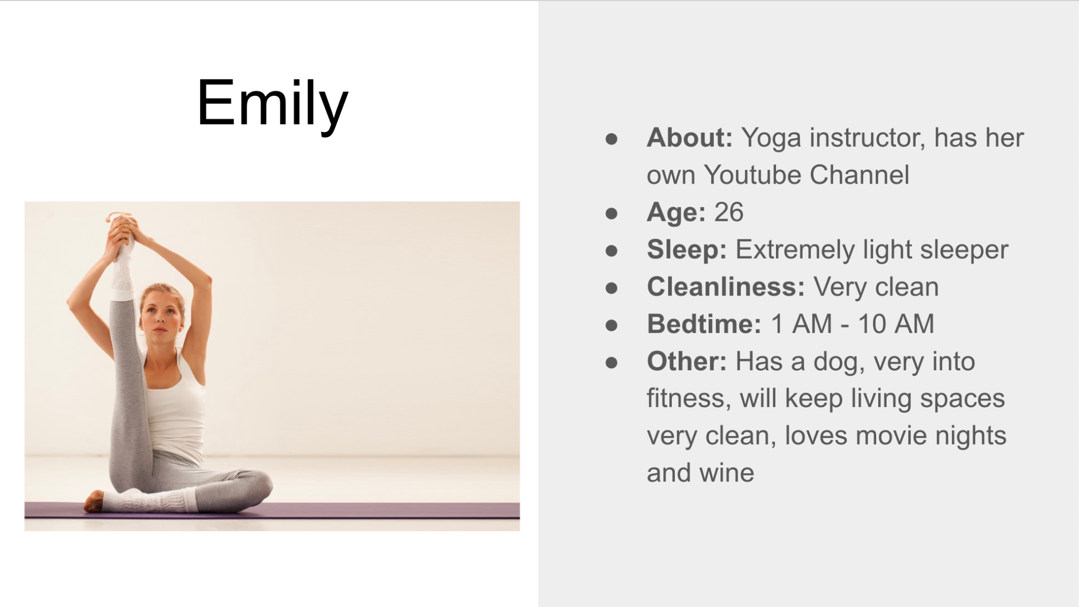
Roommate Matching App
Assumption: People are moving to a new city where they have little to no connections and are in need of finding a roommate.
The Prototype: The participant was shown a set of slides with different roommate “candidate” profiles and their living habits such as cleanliness and bedtimes. The participant was then asked to pick 2 people he would want to room with.

Slide 23

Roommate Matching App
Results:
The participant seemed to prioritize social atmosphere, bedtimes, and cleanliness the most.
Surprised to find that the participant would rather room with someone he knew with incompatible living styles than a stranger with compatible living styles.
New Learning: People want to find compatible living candidates among the people that they know or have some sort of social connection with.

Slide 24
Solution 2: Roommate Trials
How might we help people find others who they are compatible living with?

Slide 25
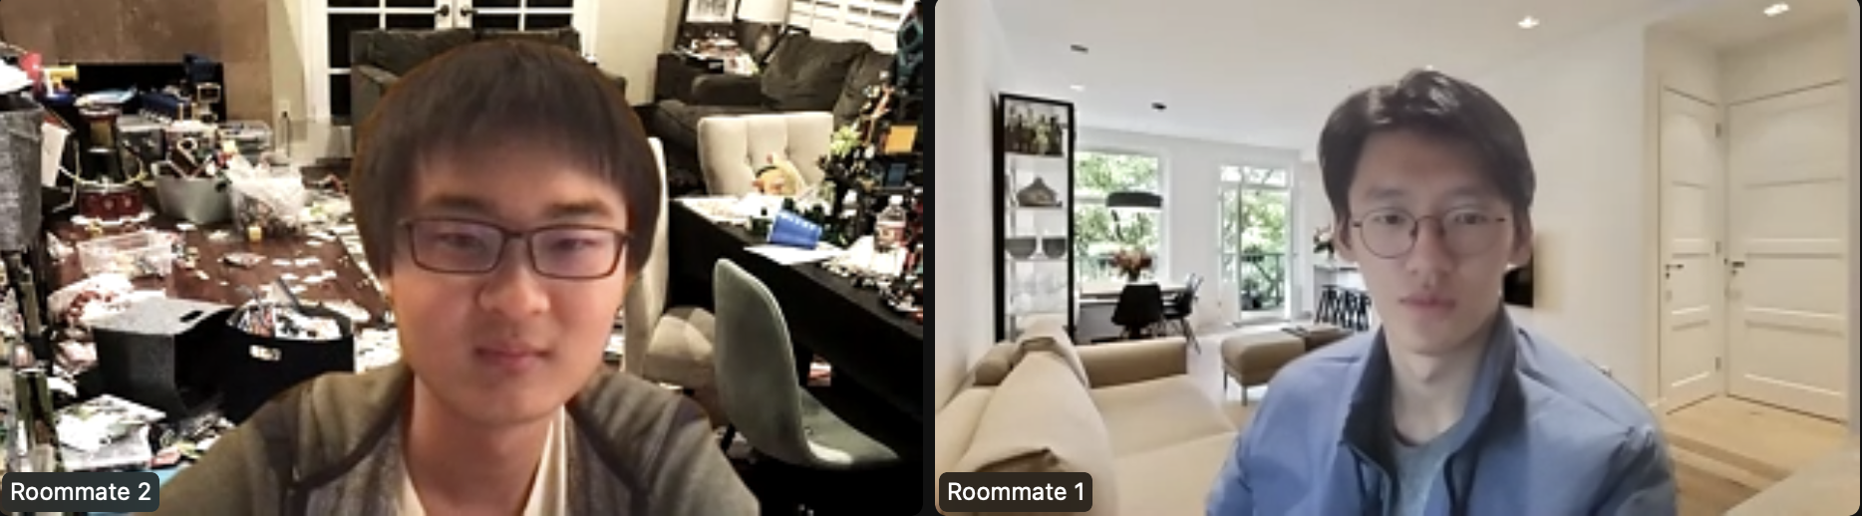
Roommate Trials
Have hesitations on a potential roommate? Never met them in person? Go on a 5 minute simulated speed date with your candidates, no commitment required!

Slide 26
Roommate Trials
Assumption
People would be willing to discuss their lifestyle with strangers (potential roommates)
Results
Things that worked:
Subject got a sense of roommate candidate’s basic qualities, including sleep time and interests
Things that didn’t work:
Lack of context for subject, would’ve also done more ‘due diligence’ before meeting
Surprises:
Was difficult to see what roommate is like online
Learnings:
Subjects need initial profiles before agreeing to meet
In-person simulation might work better
Validity:
Assumption is more invalid: participant mentioned he would’ve only agreed to meet with roommates that were screened (Eg. he would’ve never met with roommate 2 if he had seen profiles earlier)

Slide 27
Solution 3: Conflict Resolution App
How might we help roommates realize when one person has been doing more than their fair share of chores? How might we also help determine how much someone should pay for a specific living cost?

Slide 28
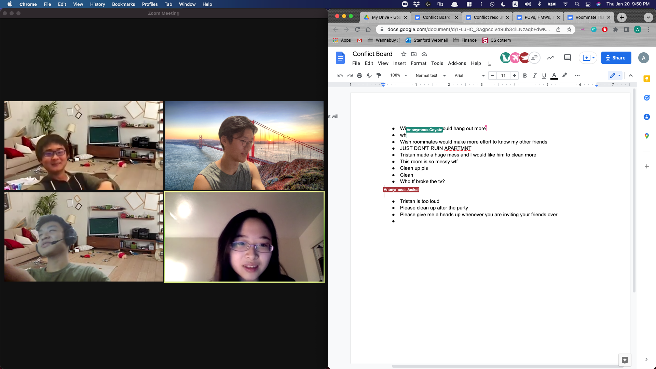
Conflict Resolution App
A platform where roommates can anonymously share grievances and complaints

Slide 29
Conflict Resolution App
Assumption
Roommates would be more open about conflicts/problems they have with each other if they can share them anonymously
Results
Things that worked:
Initiating conversations regarding conflicts between roommates
Things that didn’t work:
Anonymity can be foiled sometimes
Surprises:
Not everyone is openly ready to post on the conflict board even when there is a conflict
Learnings:
Catalyzing more communication can lead to solving conflicts
Validity:
Assumption was valid in part due to openness, but not so much on anonymity

Slide 30
Synthesized Solution - Personalized Roommate Matching App
To address the assumption that people would be more willing to live with people they know or have some sort of connection
App can have an algorithm that suggests roommates with similar qualities
If the app is connected to a Facebook or other social network, friends/friends of friends can be suggested before other matches
To address the assumption that people are willing to meet people after having done due diligence:
Detailed fields on profiles
Both people must agree to match before they meet in person
To address the assumption that people are more open about conflicts when making anonymous posts:
Suggest opening questions to compatible candidates to initiate conversation

Slide 31
9. Summary
Certain factors, such as personal living space, how noisy roommates are, and sanitization habits are important when it comes to living with others
Roommates want to have good relationships with the people they are living with, and this potential can be maximized before day 1
There are ways we can create experiences that alleviate areas of concern, such as compatibility and roommate habits

